Slide 1
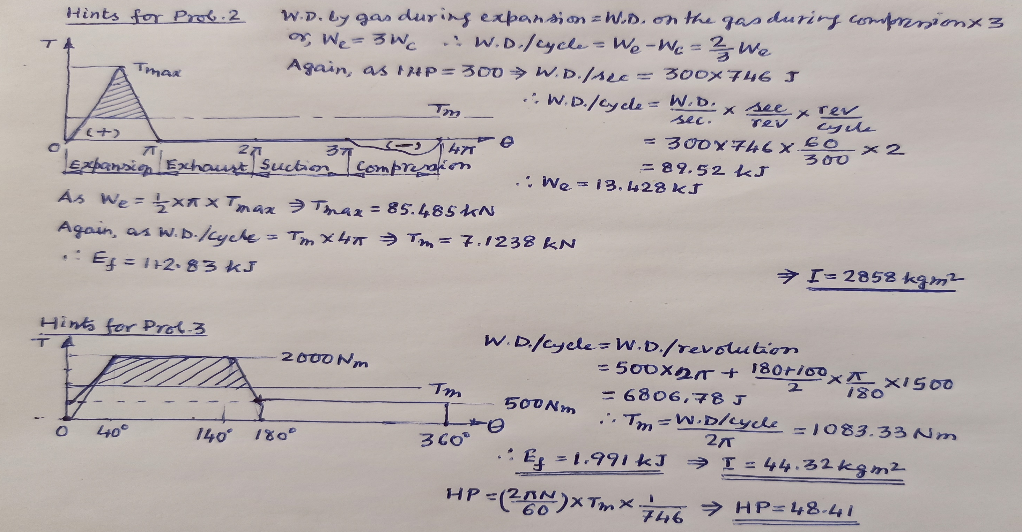
Hints for Probs. 2 and 3

Slide 2
Problems - Type 1 (ii)
Turning moment curve for an engine is represented by the equation T = (2000 + 950sin2θ -570cos2θ) in Nm where θ is the angle moved by the crank from the IDC. If the resisting torque is constant, find: (i) HP developed by the engine, (ii) Moment of inertia of the flywheel if the total fluctuation of speed is not to exceed 1% of the mean speed of 200 rpm, and (iii) angular acceleration of the flywheel when θ = 45⁰.
The equation of a turning moment curve for a three crank engine is (5000 + 1500sin3θ) Nm, where θ is the crank angle in radians. The MOI of the flywheel is 1000 kgm² and the mean speed is 300 rpm. Calculate: (a) power of the engine and (b) maximum percentage fluctuation of speed of the flywheel when (i) the resisting torque is constant and (ii) when the resisting torque is (5000 + 600sinθ) Nm.

Slide 3
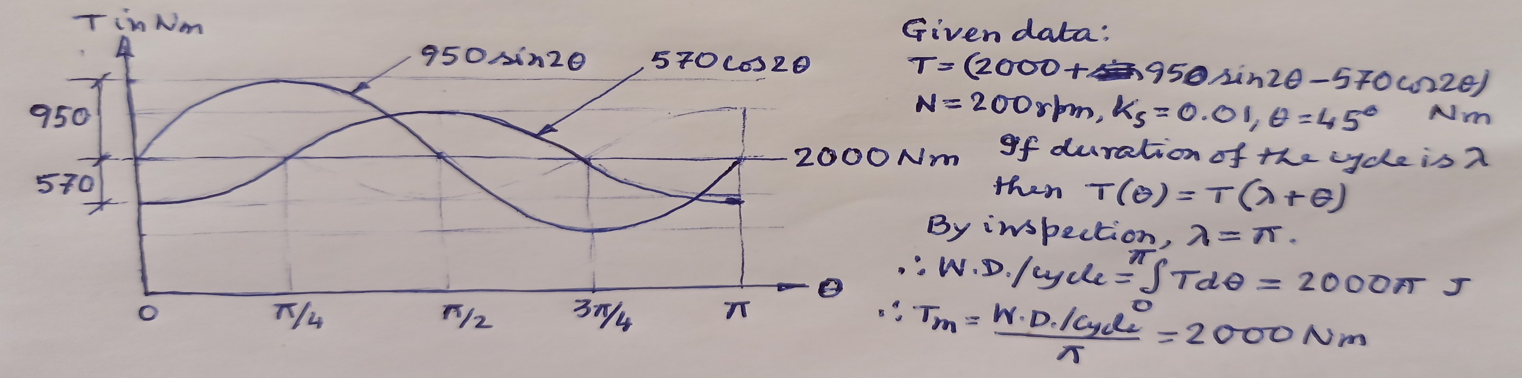
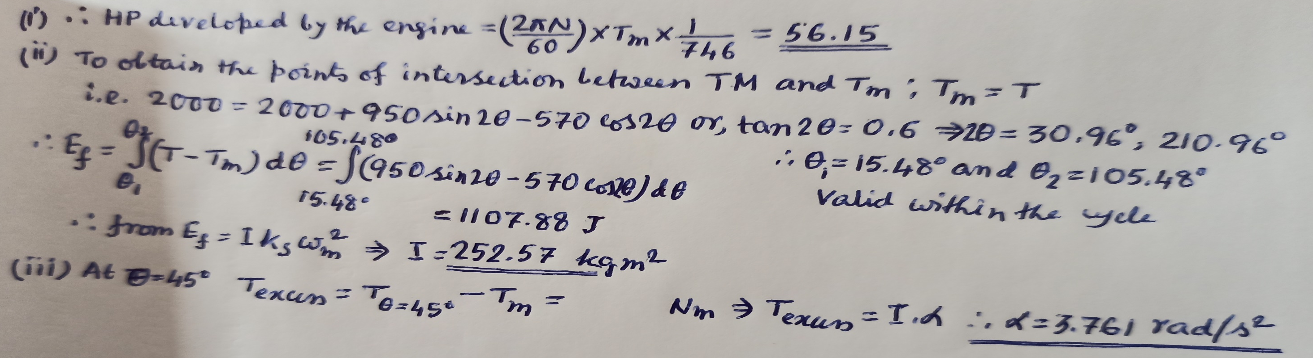
Solution of Prob. 1

